Slide 1
Improving Instruction with Technology
Whittney Smith, Ed.D.

Slide 2
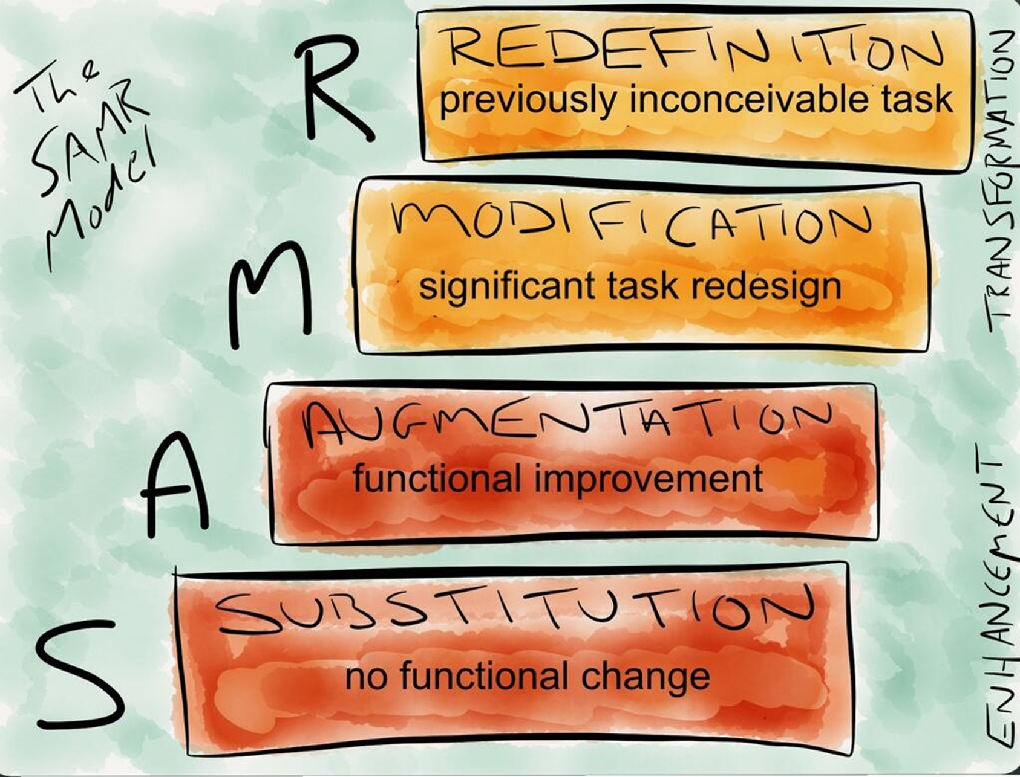

Slide 3
21st Century Learning: The 4 Cs
The Four Cs
Teaching Digital Natives by Marc Prensky
The Flipped Classroom
Twitter and social media
iPads
Web 2.0: Blogs and Wikis
Podcasting and Screencasting
Khan Academy

Slide 4
The Four Cs

Slide 5
A text to work from…
Ch. 1: More positive look at 21st century students; partnering pedagogy and “new roles”
Ch. 2: Implementing partnering pedagogy; “leaving the stage;” verb/noun distinction
Ch. 3: Using student passions
Ch. 4: “Real, not just relevant”
Ch. 5: Guiding questions, verbs (skills)
Ch. 6: Using technology in partnering
Ch. 7: >130 Technologies
Ch. 8: Student creation
Ch. 9: Continuous improvement through sharing
Ch. 10: Assessment

Slide 6
“Partnering”
Learning a new way with different roles; conceptual changes
Students: focus on using new tools, finding information, making meaning, and creating
Teachers: focus on questioning, coaching, and guiding, providing context, ensuring rigor and meaning, and ensuring quality results

Slide 8
The Flipped Classroom
With teacher-created videos and interactive lessons, instruction that used to occur in class is now accessed at home, in advance of class. Class becomes the place to work through problems, advance concepts, and engage in collaborative learning. Most importantly, all aspects of instruction can be rethought to best maximize the scarcest learning resource—time.

Slide 9
Khan Academy
Using it…
Supplemental models: learning lab, optional or additional homework tool, a curriculum resource
Individualized units: some teachers use Khan Academy to create individualized units, in which students cover grade-level standards at their own pace.
Future models: challenging some of the basic assumptions in education to meet each student’s needs. Some ideas:
Mixed-age classes
Self-paced learning, even outside of grade-level standards (i.e., students could learn topics below or above grade level, depending on their needs)
Significant use of real-world problem-solving and meaningful project-based learning
Cross-disciplinary courses

Slide 10
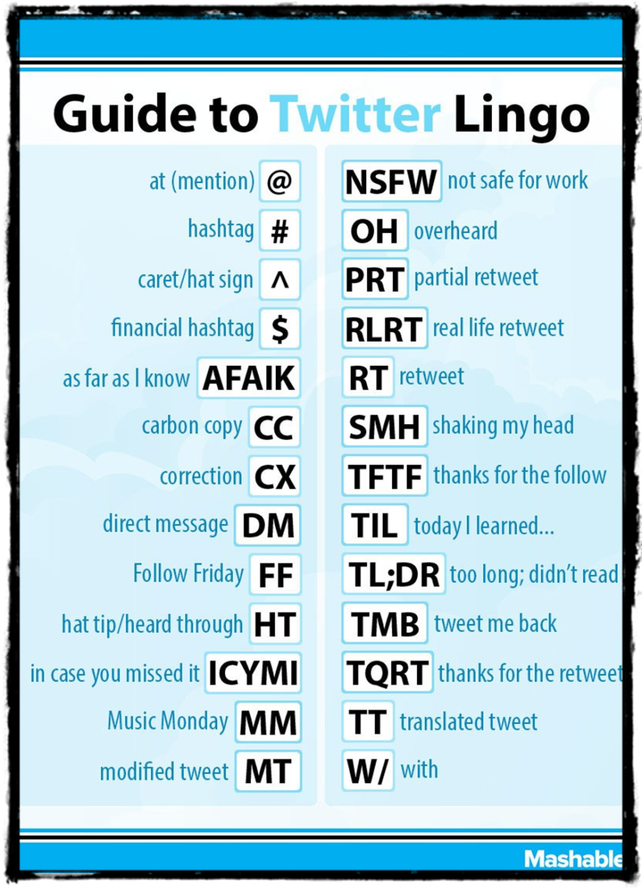
The “Twitterverse”
Professional Learning Networks
EdChats
Follow:
@wsmithatc
@mineolaguidance
Hashtags:
#mhsbyod

Slide 11
The shortlist of “Ed Chats”

Slide 12
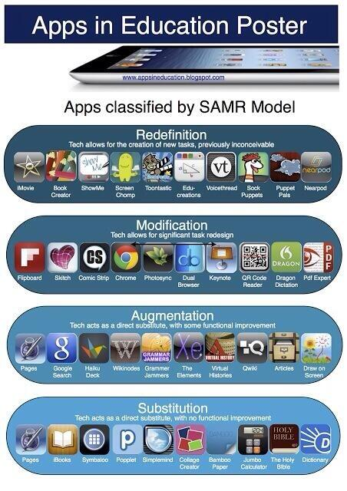
iPads
S.A.M.R. Model
Shift Instruction (“pedagogy is the driver, technology is the accelerator”)
Collaboration (Twitter; face-to-face; webpage)
Apps

Slide 13
Web 2.0
Blogs
Wikis
Edmodo
Blogger
Weebly
Edublogs
Wikispaces
PB Works
Wikidot

Slide 14
Podcasting and Screencasting
Show Me
Doceri
Jing
Snagit
ScreenChomp
Camtasia
Audacity
Garageband
ActivInspire or SMART notebook
Podcast Example:
http://bobsprankle.com/podcasts/0506/rm208vodcast.mov

