Slide 1
Beyond Discipline
From Compliance to Community
Whittney Smith, Ed.D.

Slide 2
Assumptions
Learning is intrinsically motivated
Rewards and punishments reduce intrinsic motivation
Rewards produce temporary results

Slide 3
Premise
Students are responsible for their own behavior
Students are capable of controlling their own behavior
We need to work with children to encourage their social and moral development which means utilizing their need to…
be able to make their own decisions
belong
learn and apply learning

Slide 4
What we believe matters
“Someone who thinks that kids are always trying to get away with something is likely to believe that we adults must overcome these unsavory motives, force children to obey rules, and see to it that they are punished when they don’t.” (Kohn p. 8)

Slide 5
Classroom
Content
Community
Choice
Right Answer Approach | Right Behavior Approach
Information transmitted | “constructivist”
Accept and memorize worksheets | Active meaning-making Grappling with perspectives Collaboration

Slide 6
Classroom
Content
Community
Choice
No Competition
No Rewards
Encouragement
Respect
Sense of Belonging
Class Meetings

Slide 7
Classroom
Content
Community
Choice
“Working with” | “Doing to”
Increase self-discipline
Doing the right thing when no one is looking
Developing one’s own expectations | Accepting someone else’s expectations
Real choice = commitment; self-confidence; interest in learning for learning’s sake

Slide 8
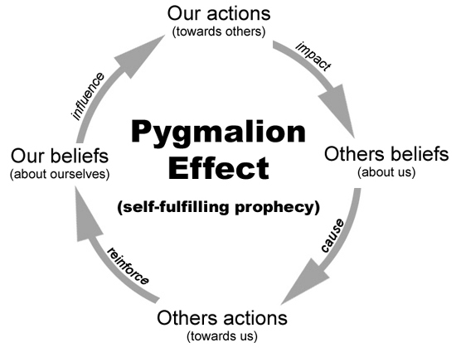
Do you Believe in Me?
Pygmalion effect
When teachers were led to believe that their students had extraordinary intellectual potential, these average students really did end up achieving impressively in their classes.

